Slide 1
Edinburgh Art Time
Group3: Xinyan Chai, Yeru Lin, Ziyu Yang, Wenyun Deng, Zihan Yuan
Tutor: Corhran David
Data-holder: Currie Morgan

Slide 2
Content
(1) Introduction
(2) Data Analysis
(3) Demo
(4) Reflection

Slide 3
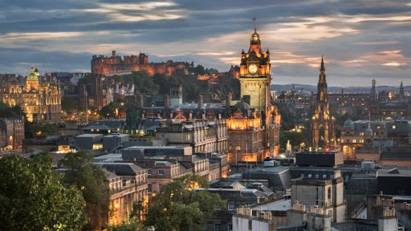
Introduction
Challenge: Cultural map of Edinburgh
Project Name: Edinburgh Art Time
Audience: Visitors to Edinburgh
Introduction
Our project is mainly focused on the public art (sculpture) and street art in Edinburgh.We try to combine digital and physical techniques to help people know more about public art and understand the development of Edinburgh art from the perspective of time.

Slide 4
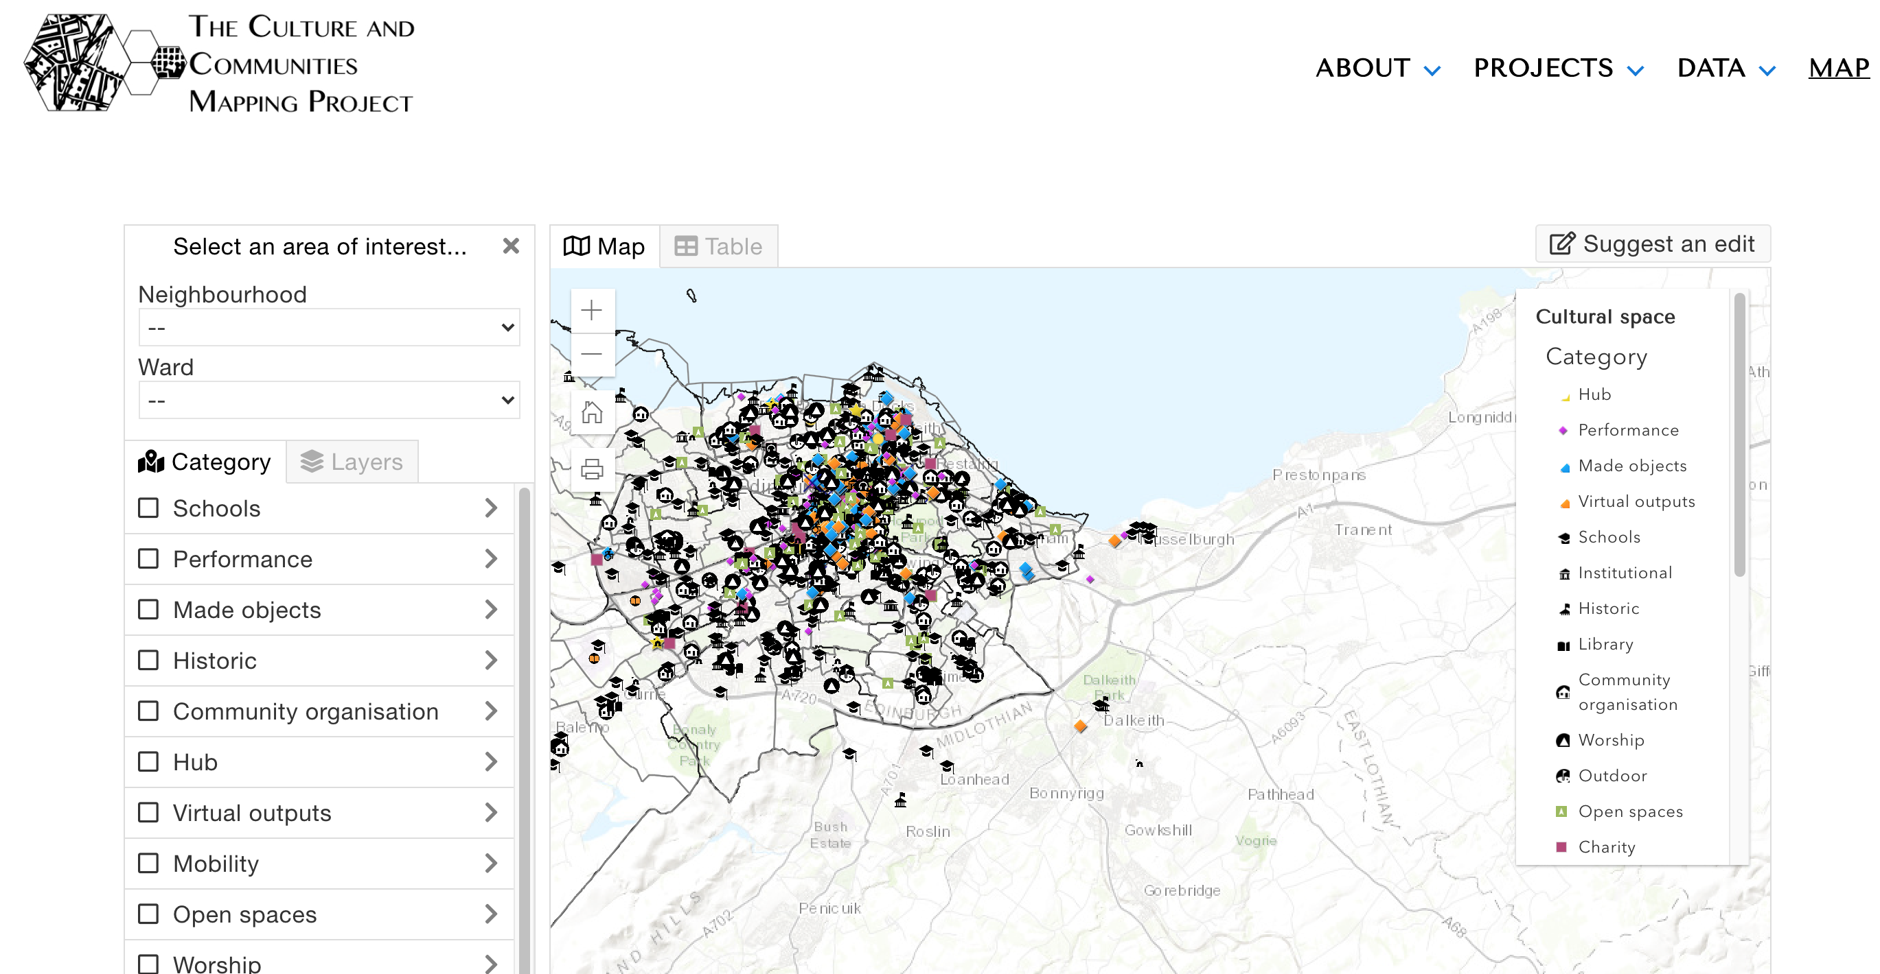
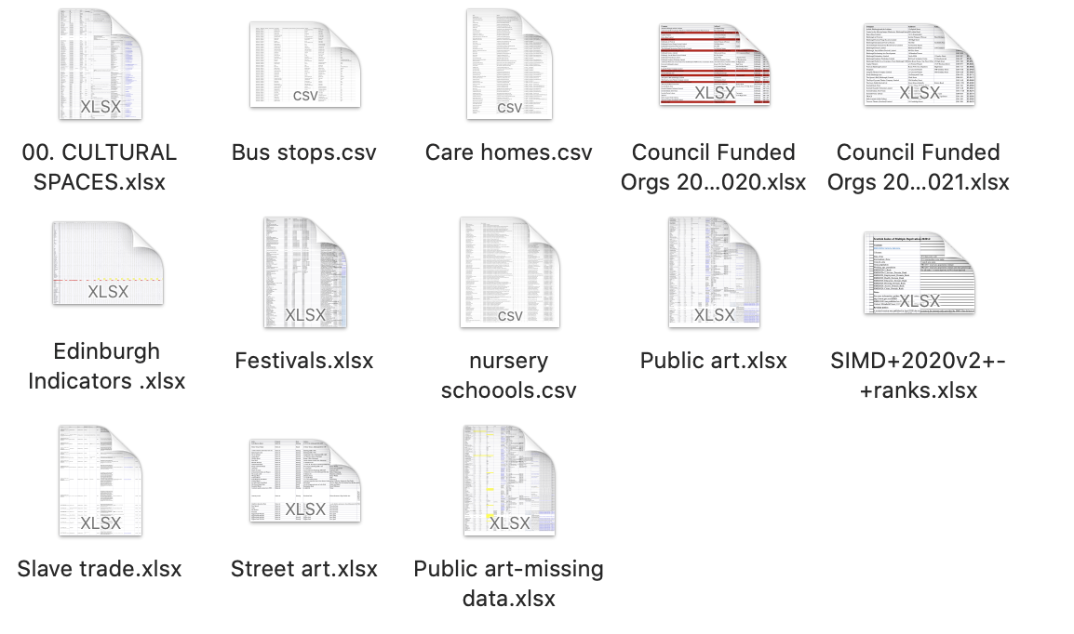

Introduction
Data:
Data documents about Edingburgh culture, such as arts, bus stops, society, etc.
Our group finally choose the data related to art including public art.csv (data of sculpture), and street art.csv.
We download the data from the cultural and communities mapping website project
https://www.edinburghculturalmap.org/

Slide 5
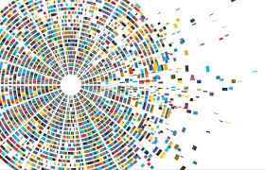
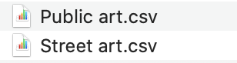
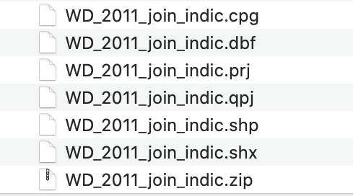
Data analysis
Data format:
CSV
SHP
Analysis tools:
Python
JavaScript
(Timeline.js)
Arcgis

Slide 6
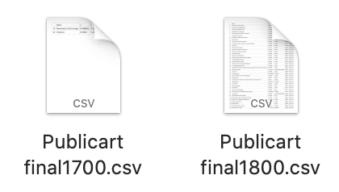
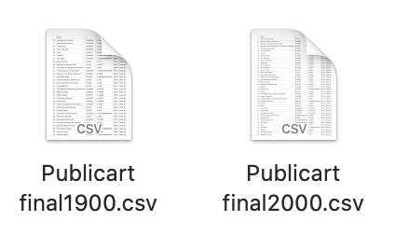
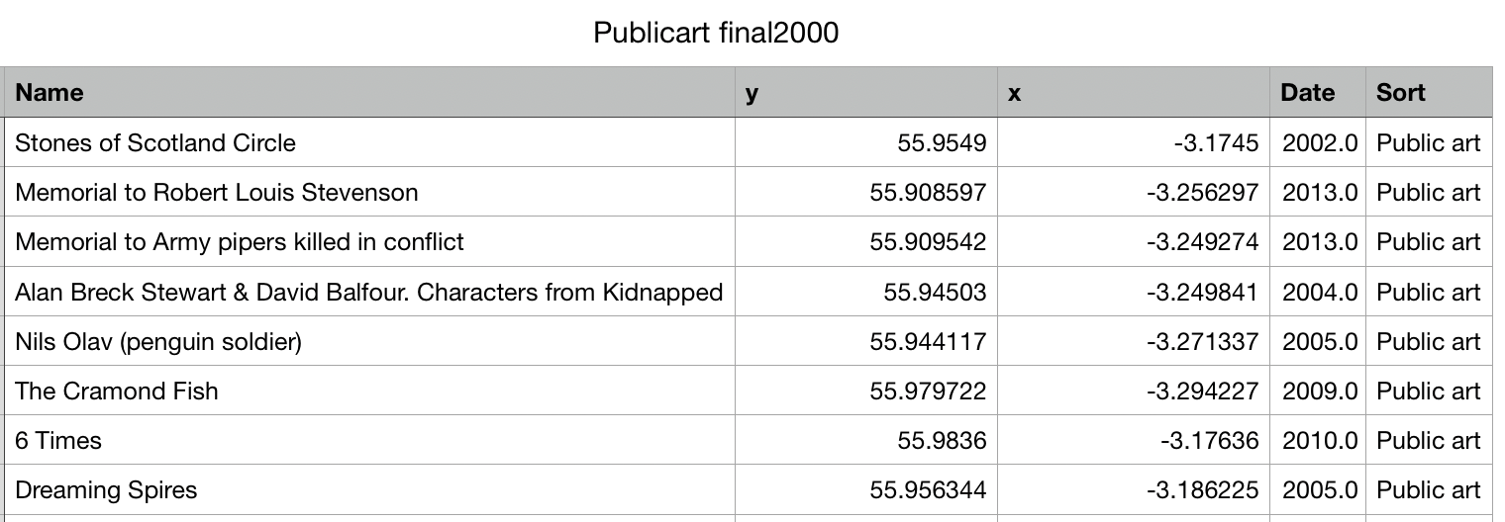
Analysis Methods - Python
Python: Pandas, Numpy, Geopandas, Folium, Seaborn
Data Cleaning (Pandas, Numpy)
Notes:
打开public art 只剩年份，位置
链接3个表，并导出
按年份将公共艺术分类4类，分别放入4个表，并导出

Slide 7
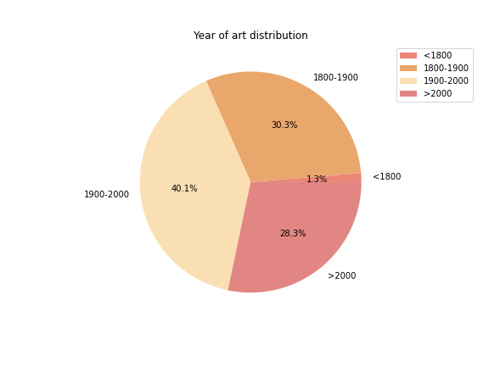
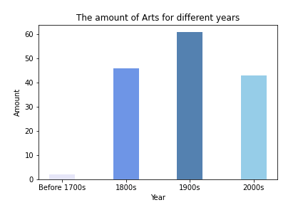
Analysis Methods - Python
Data Analysis (Seaborn)
- The 20th century saw the most public art (40.1%).
- Public art before the 19th century made up only 1.3% of the total.
- The number of newly established public arts increased with each century.
Notes:
打开public art 只剩年份，位置
链接3个表，并导出
按年份将公共艺术分类4类，分别放入4个表，并导出

Slide 8
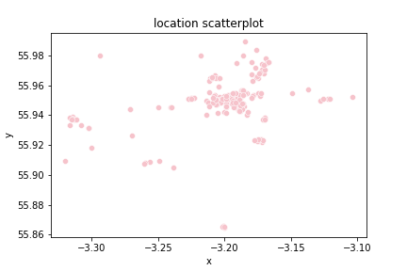
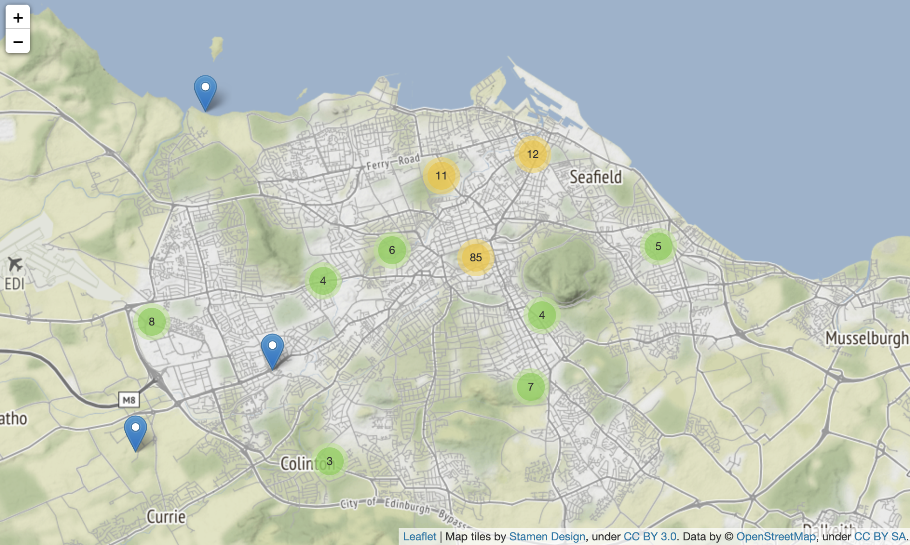
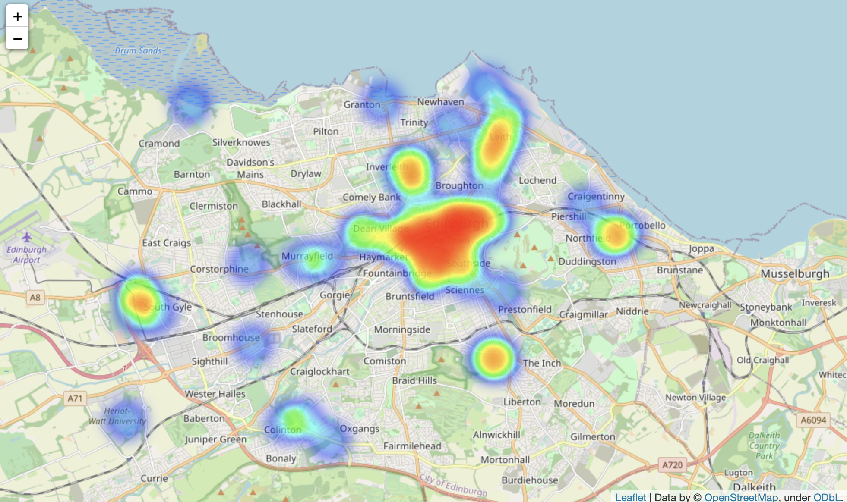
Analysis Methods - Python
Data Analysis (Seaborn, Folium)
The geographical distribution of public art in Edinburgh.
From this location scatterplot, we find that the public art are concentrated mainly in the ‘city centre’.
-
After the data analysis, we try to use our physical map show the distribution of public art throughout Edinburgh and choose city center to show the specific times for each public art.
Notes:
打开public art 只剩年份，位置
链接3个表，并导出
按年份将公共艺术分类4类，分别放入4个表，并导出

Slide 9
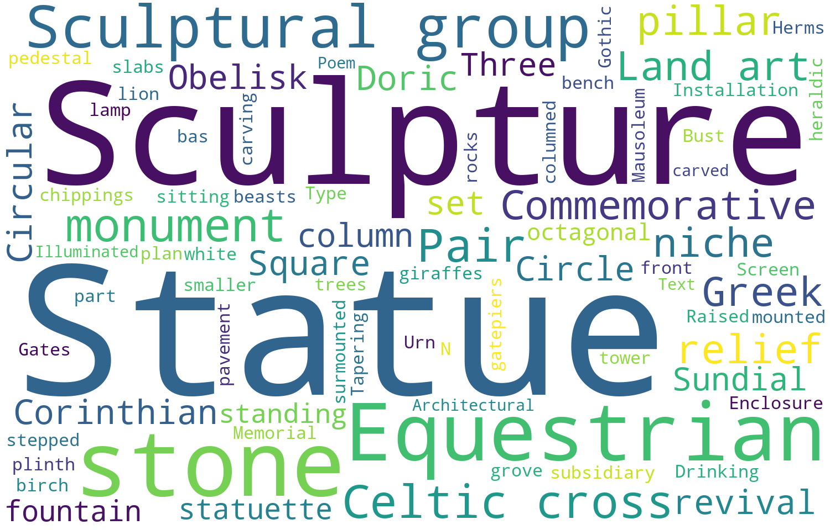
Analysis Methods - Python
Data Analysis (Seaborn, wordcloud)
Our data set describes the different types of public art in the form of words. In this way, we use the word cloud to do the data analysis.
From this wordcloud, we can find that the most common type of public art in Edinburgh is sculpture, statue, sculpture group, stone and monument.
-
Notes:
打开public art 只剩年份，位置
链接3个表，并导出
按年份将公共艺术分类4类，分别放入4个表，并导出

Slide 10
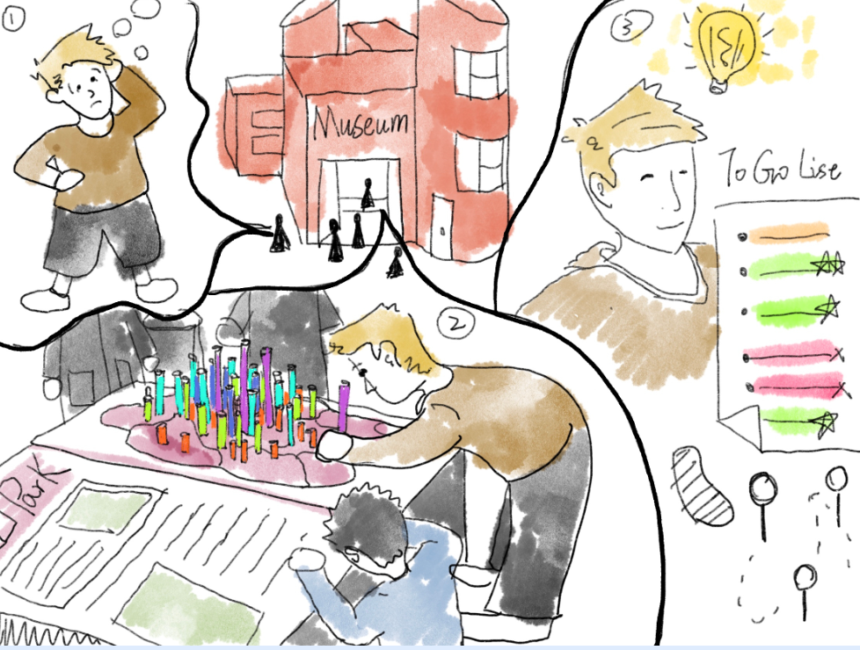

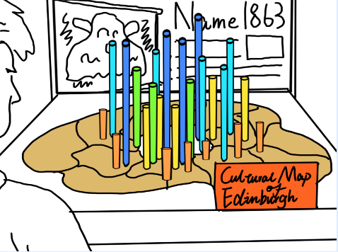
Demo
Story board
（1）Kevin is a new tourist in Edinburgh. He went to the museum to learn about this place.
（2）He found the 'Edinburgh Art Time' and learn more about the public art distribution and its development history.
（3）He touch the coloums which represents a public art in city center and see more detail information in the interactive screen.

Slide 11
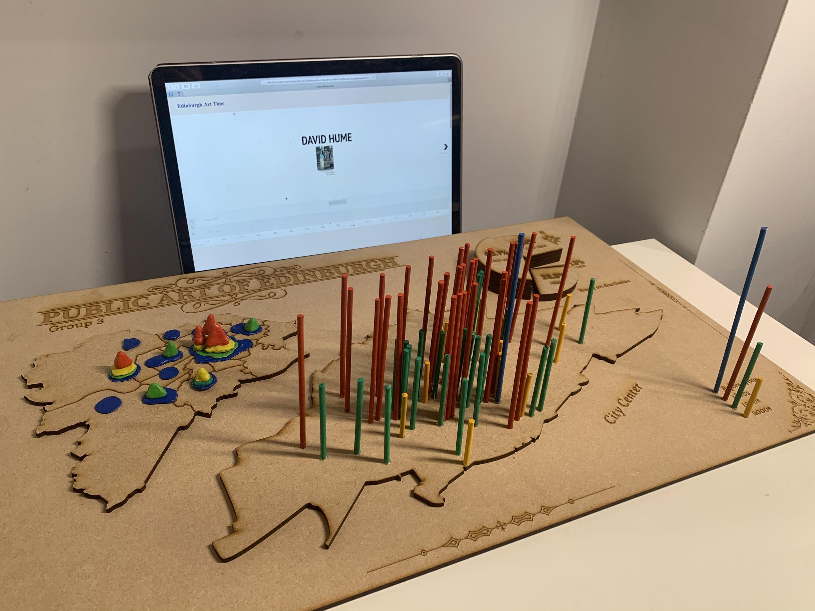
Demo
Our prototype is mainly composed of two parts parts: Interactive screen, physical map
Interaction Screen
Physical map

Slide 12
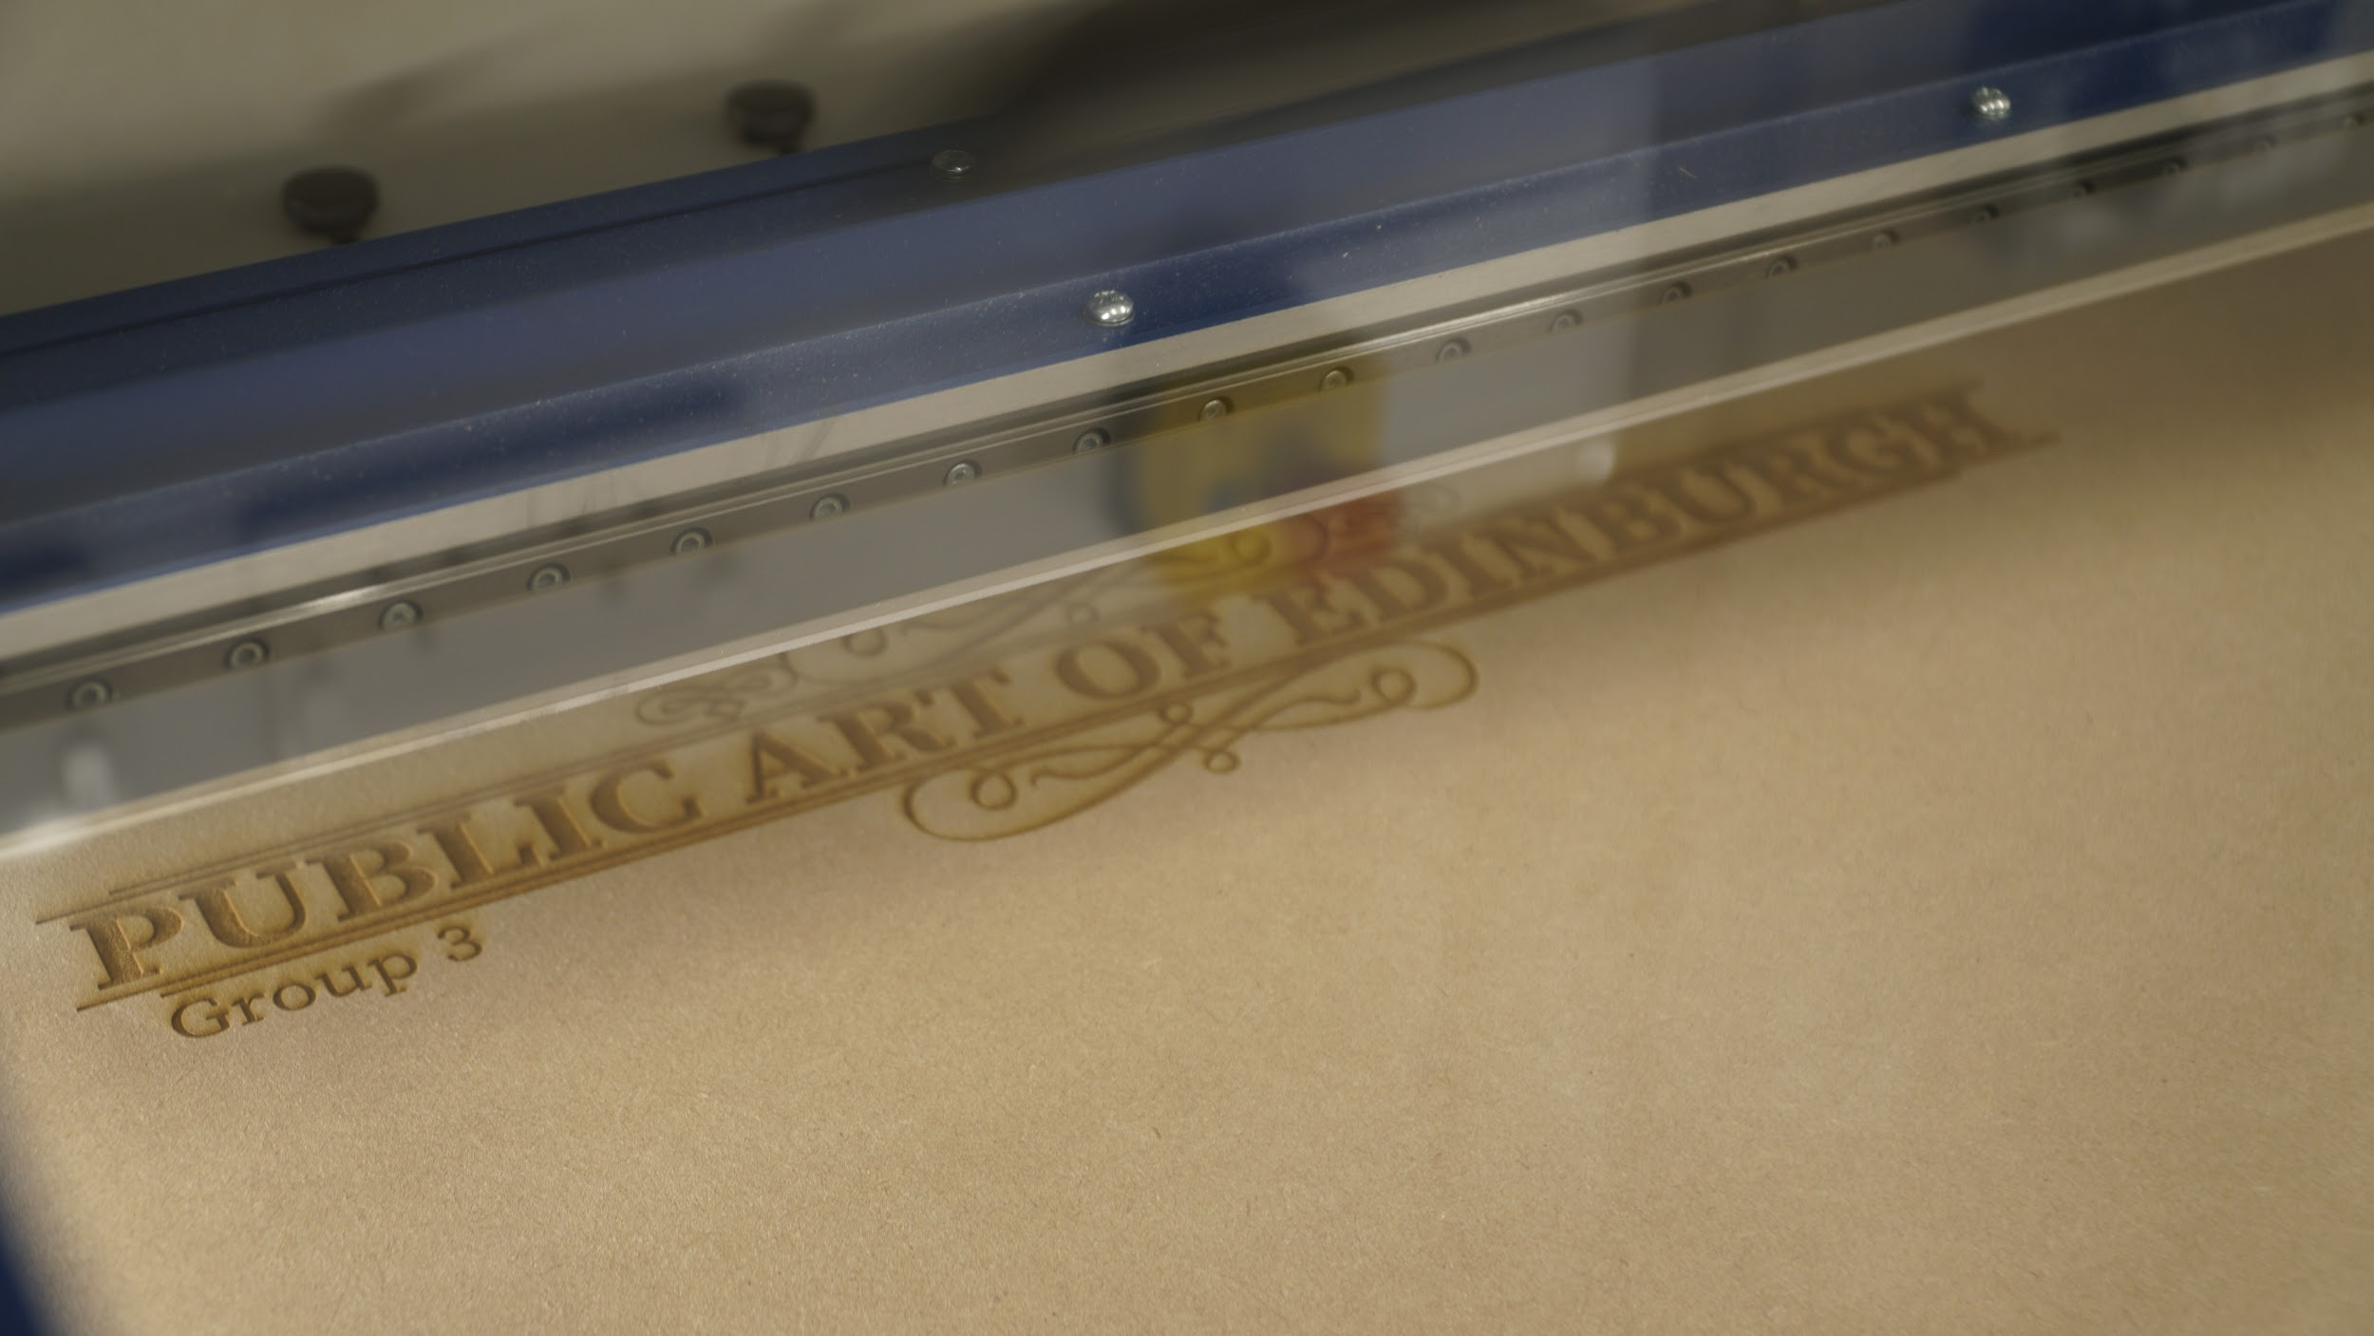
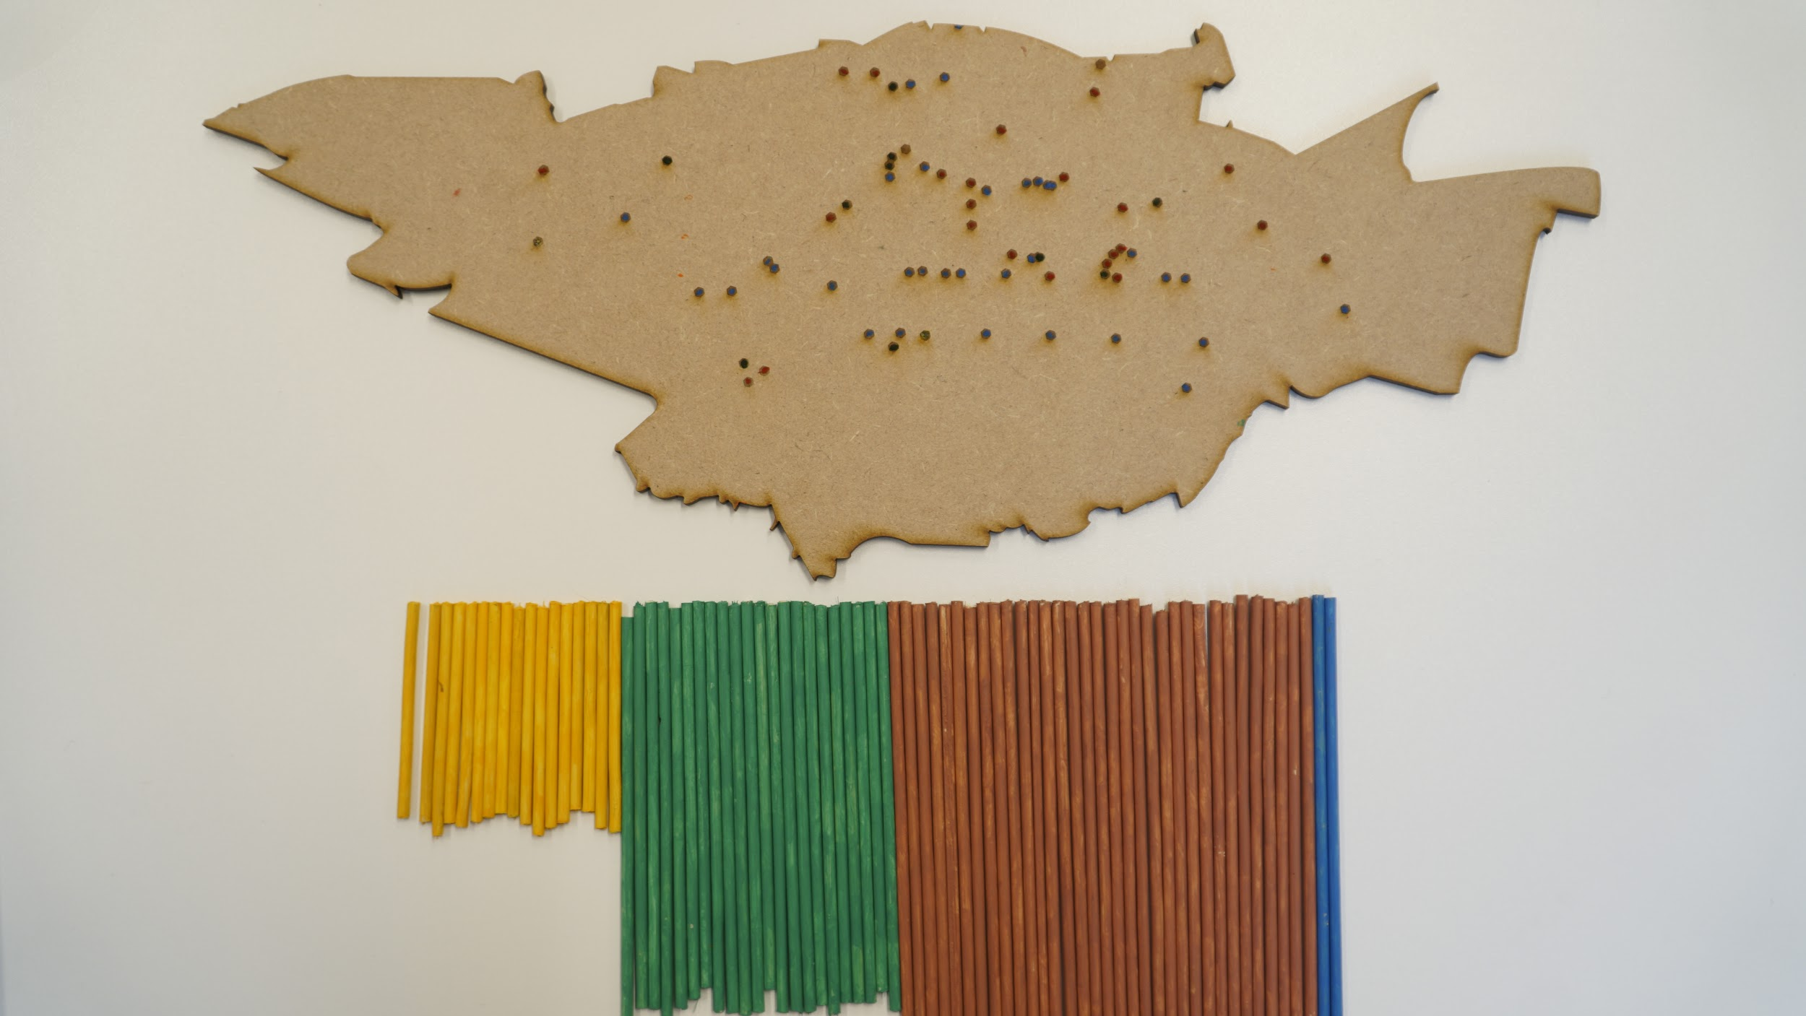
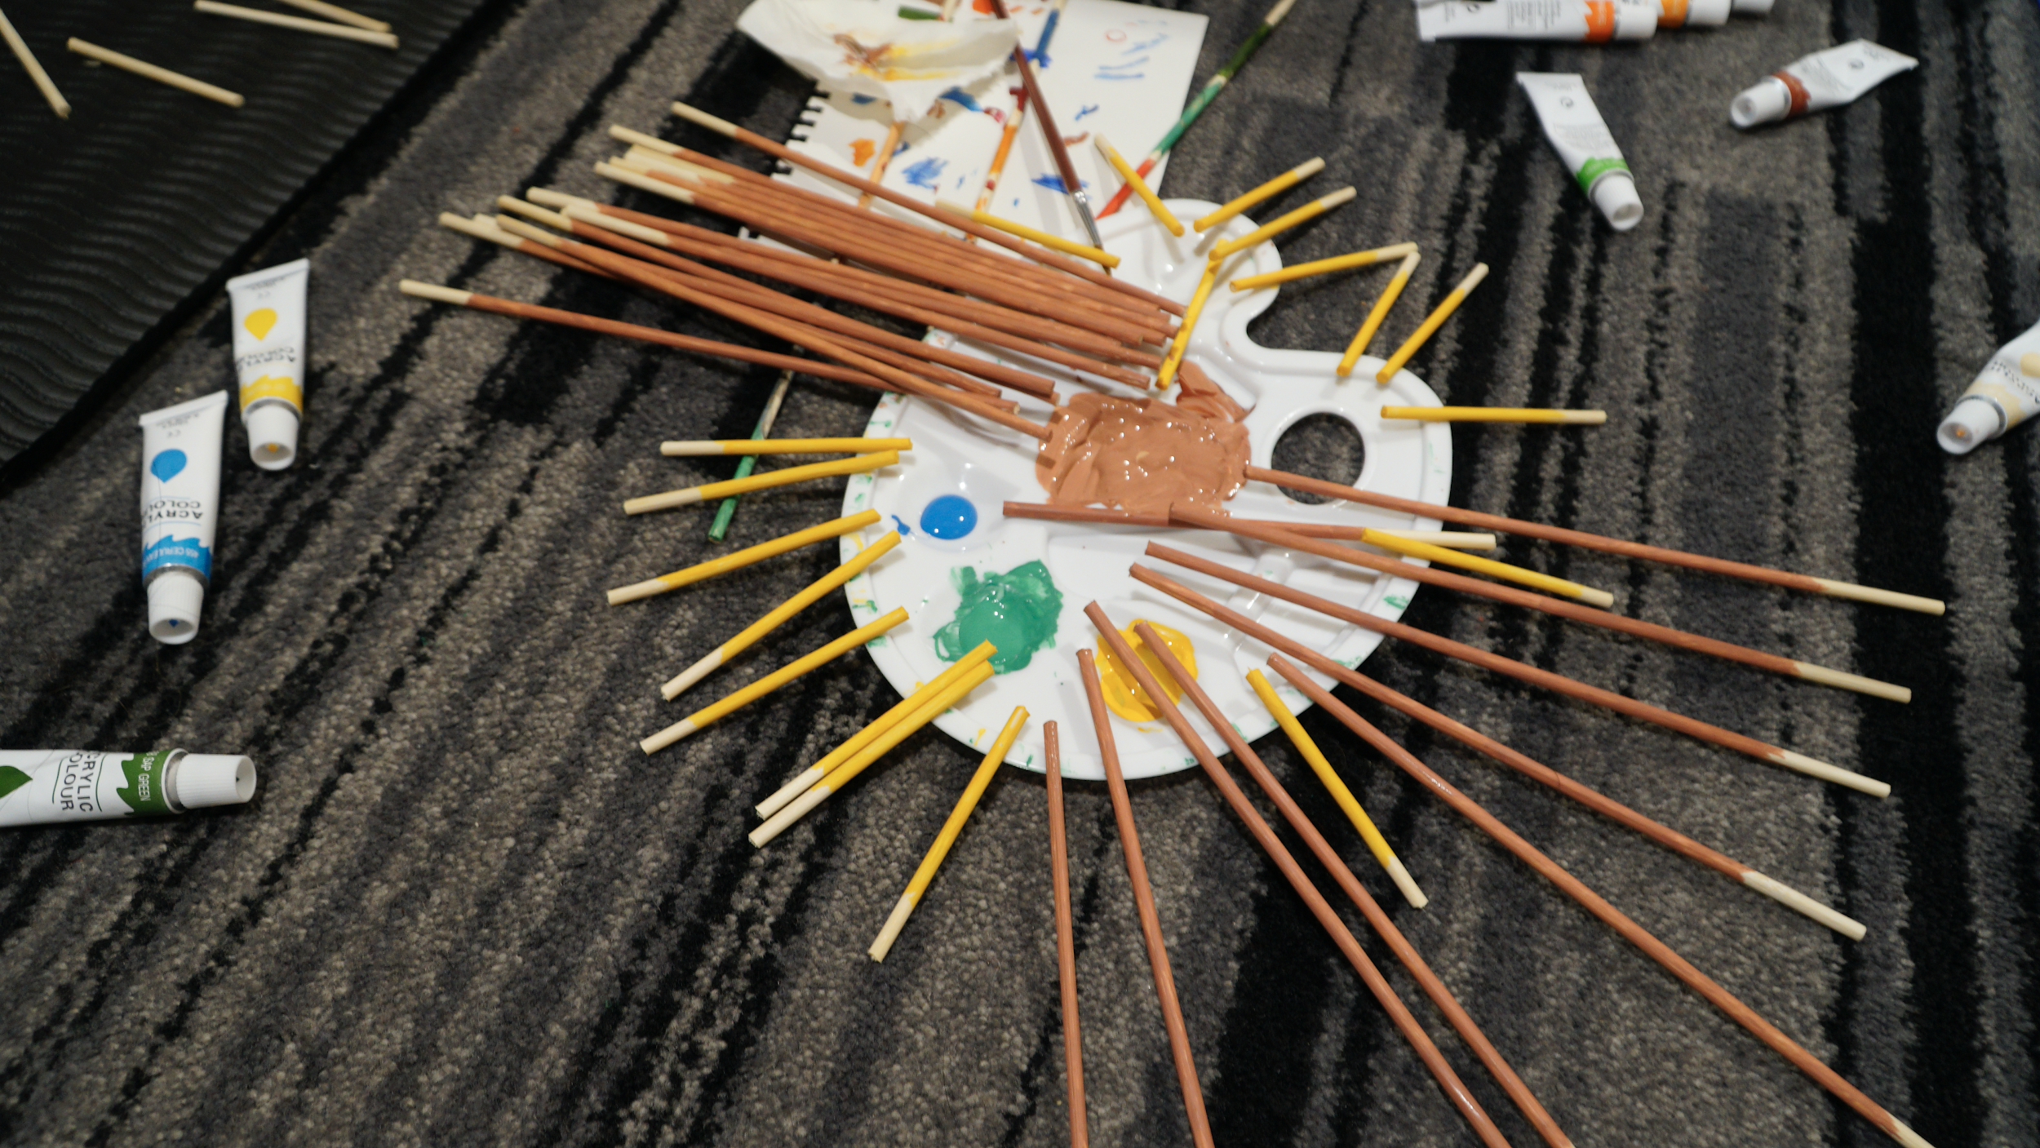
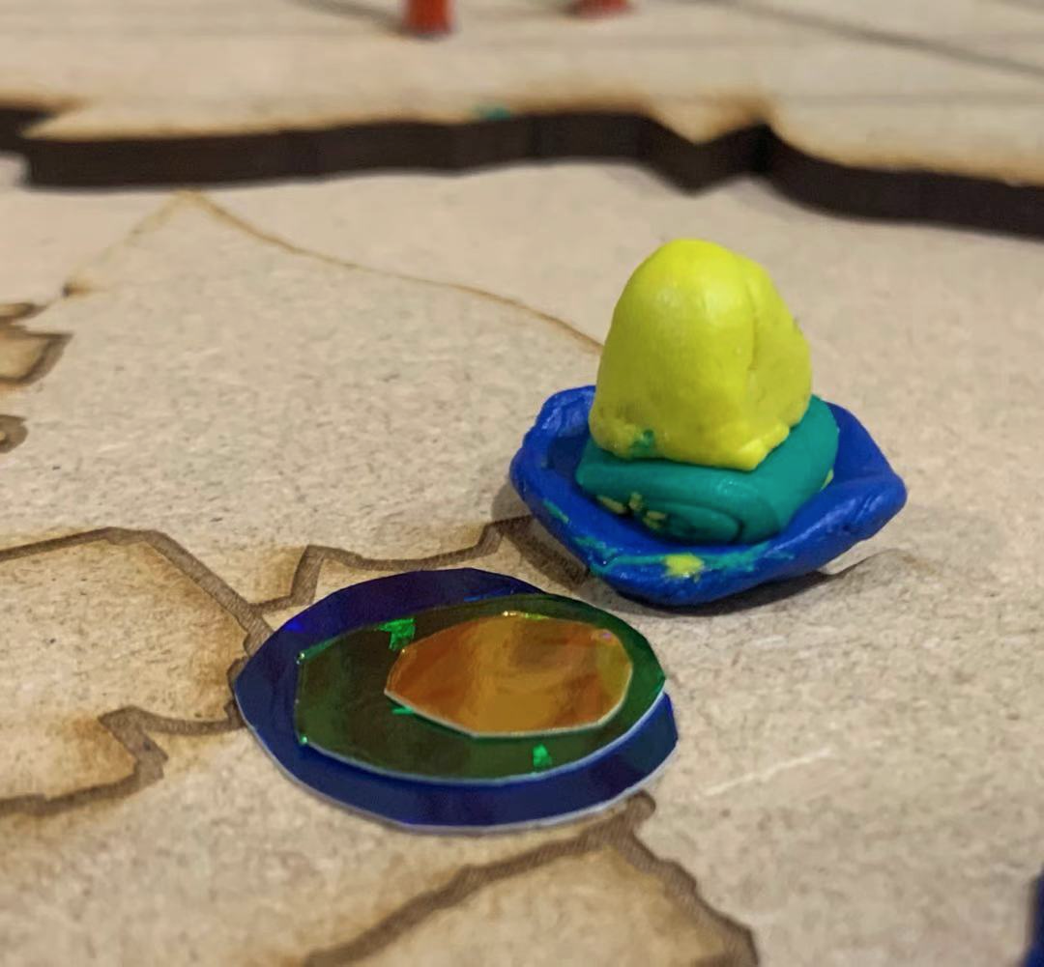
Physical map —— making process
The dots shows the location of each public art.
Laser cutting
The number of columns shows how many public art of different centuries in city center
Map board
The length show how long the public art exist.
Painting Sticks
Painted sticks
Plasticine

Slide 13
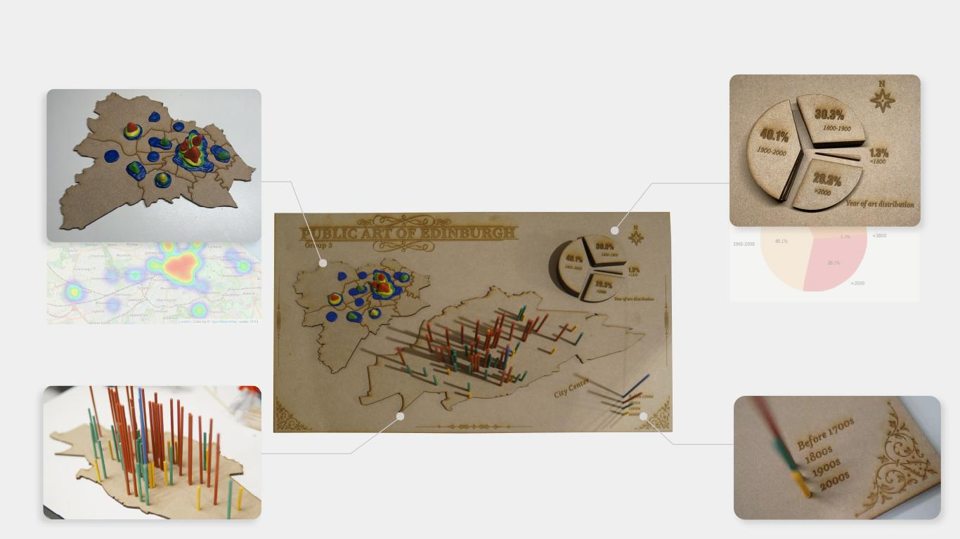
Physical map —— detail imformation
Time distribution
Before 1800： 1.3%
1800-1900： 30.3%
1900-2000：40.1%
After 2000: 28.3%
Space distribution in Edinburgh
Heat map
Legend
We focused on the art in the City Center as they are mostly in this area

Slide 14
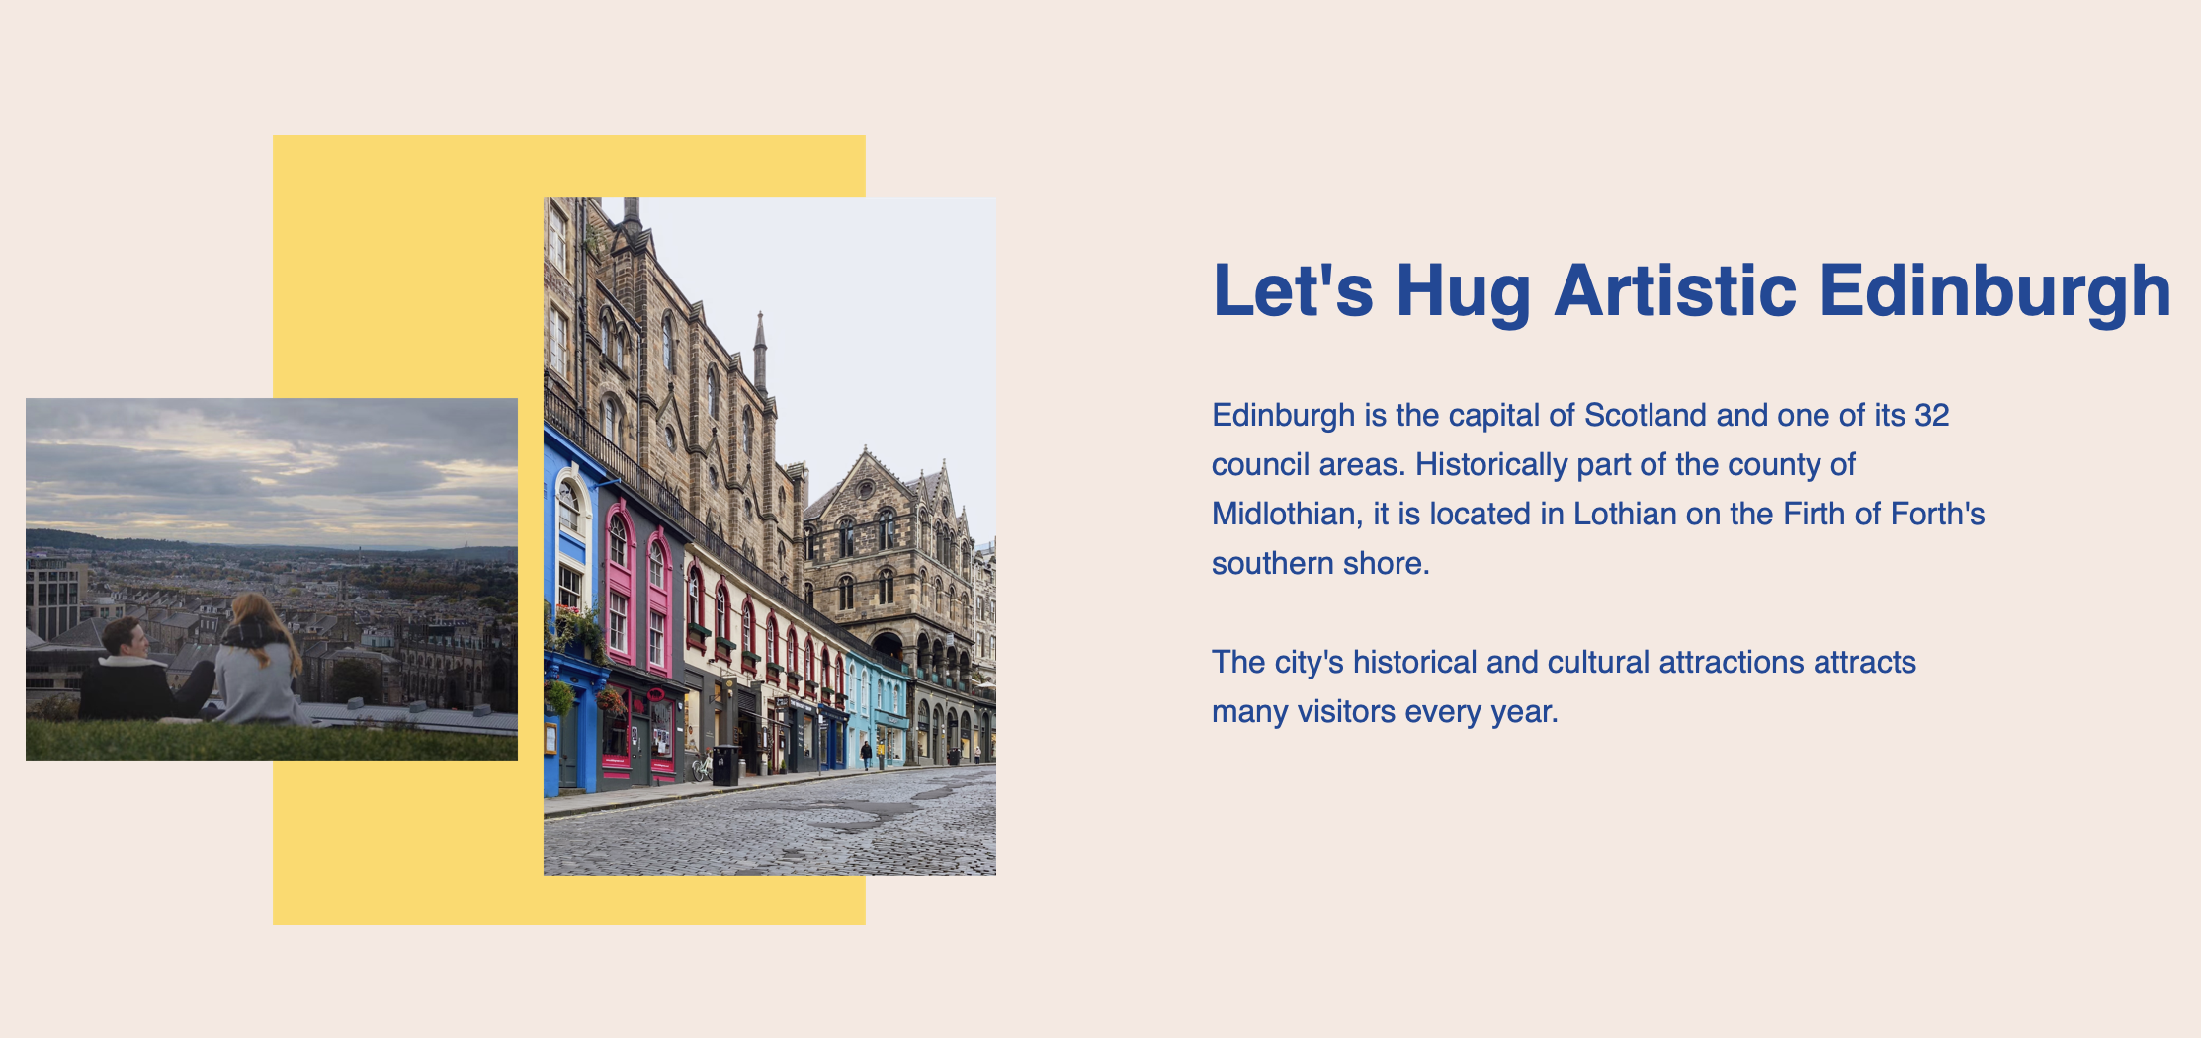
Interactive Screen
To order to improve the interactivity for the audience and show them more information of public art in Edinburgh, we link the interactive screen to our physical map.
Our interactive screen have 3 parts
- introduction
- Interactive timeline
- general data visualization of public art.
Technology:
aos.js, Leaflet.js, timeline.js, chart.js
The cover page
https://linyeru.github.io/Map/index

Slide 15
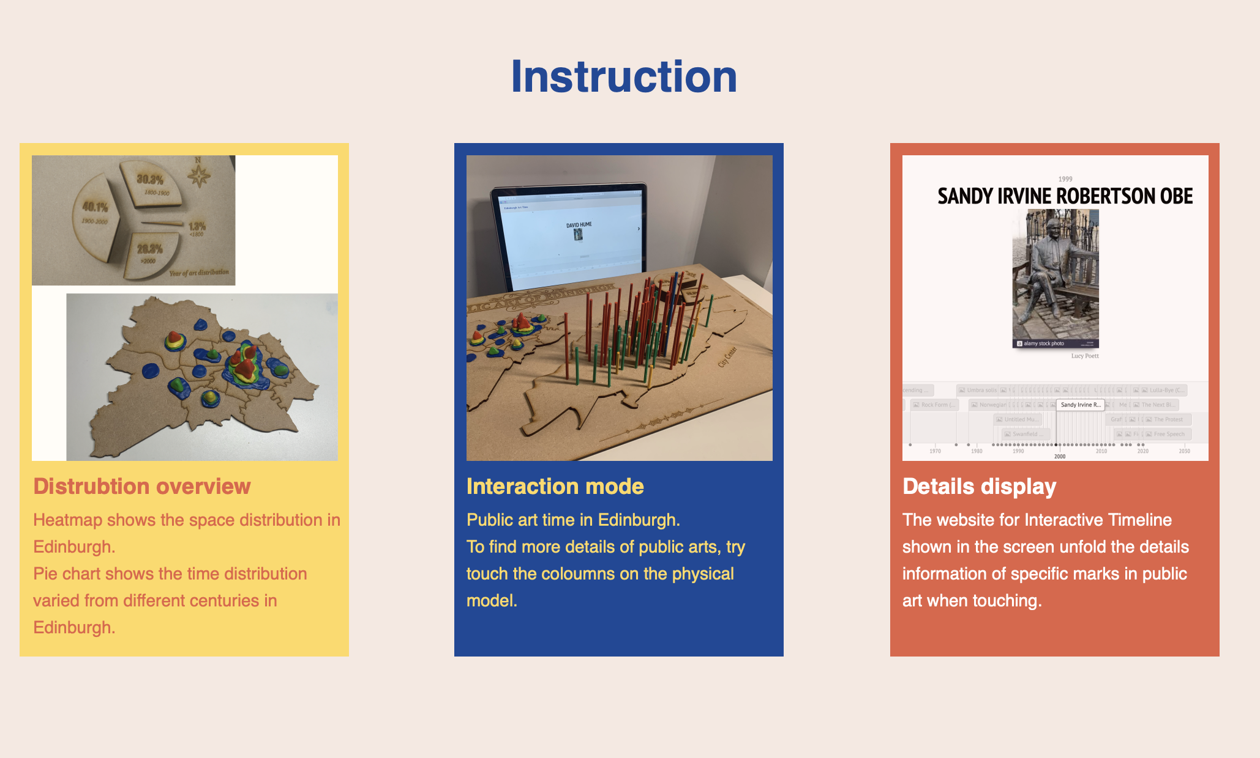
Interactive Screen
Part one:
Introduce our hold project generally.
Let the audience what information our physical map will show them. How to interact with the map and give some more details of each public art in city center.

Slide 16
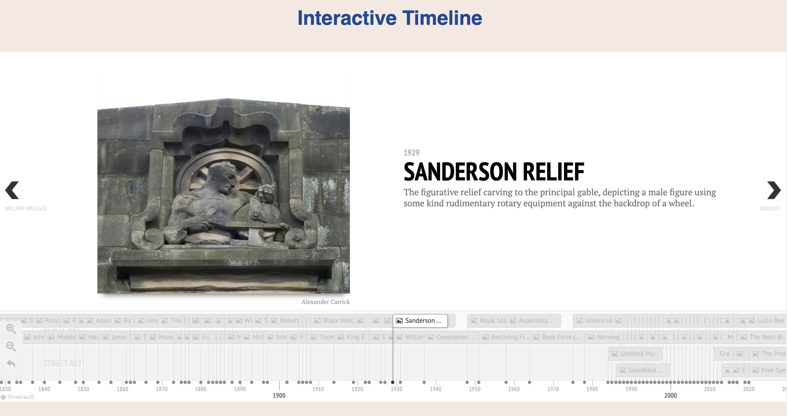
Interactive Screen
Part two:
Interactive timeline
When people touch the coloum in our physical map, this timeline will automayically show the detail information of this place.

Slide 17
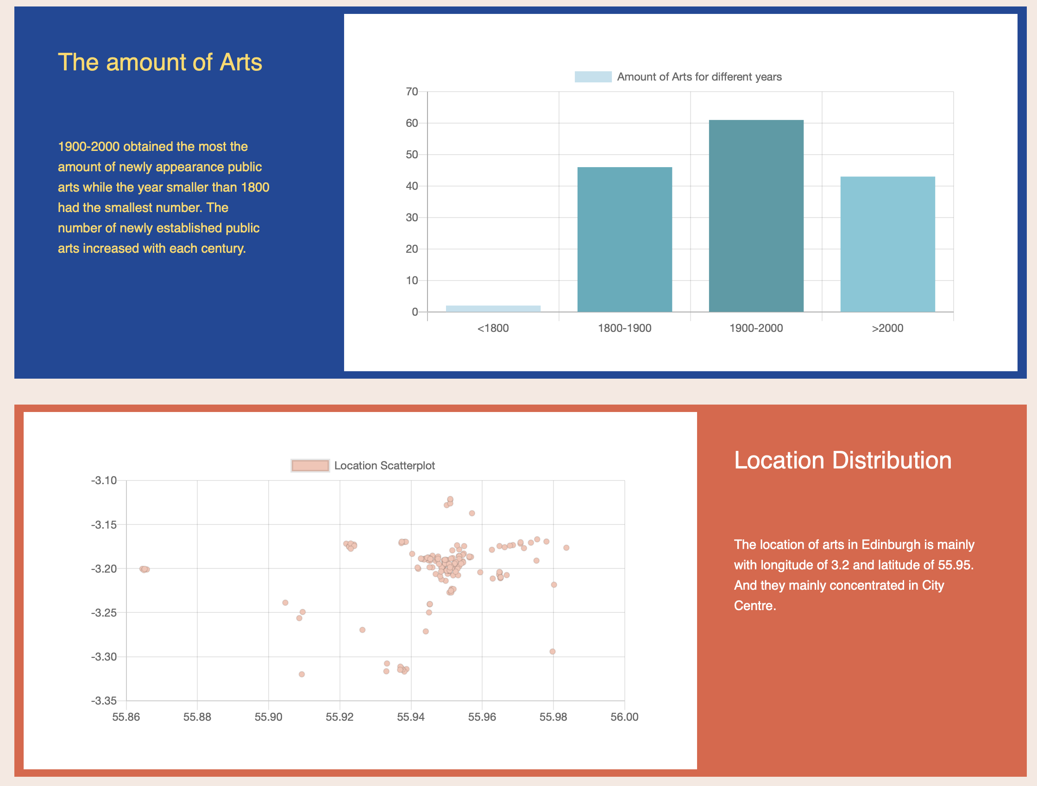
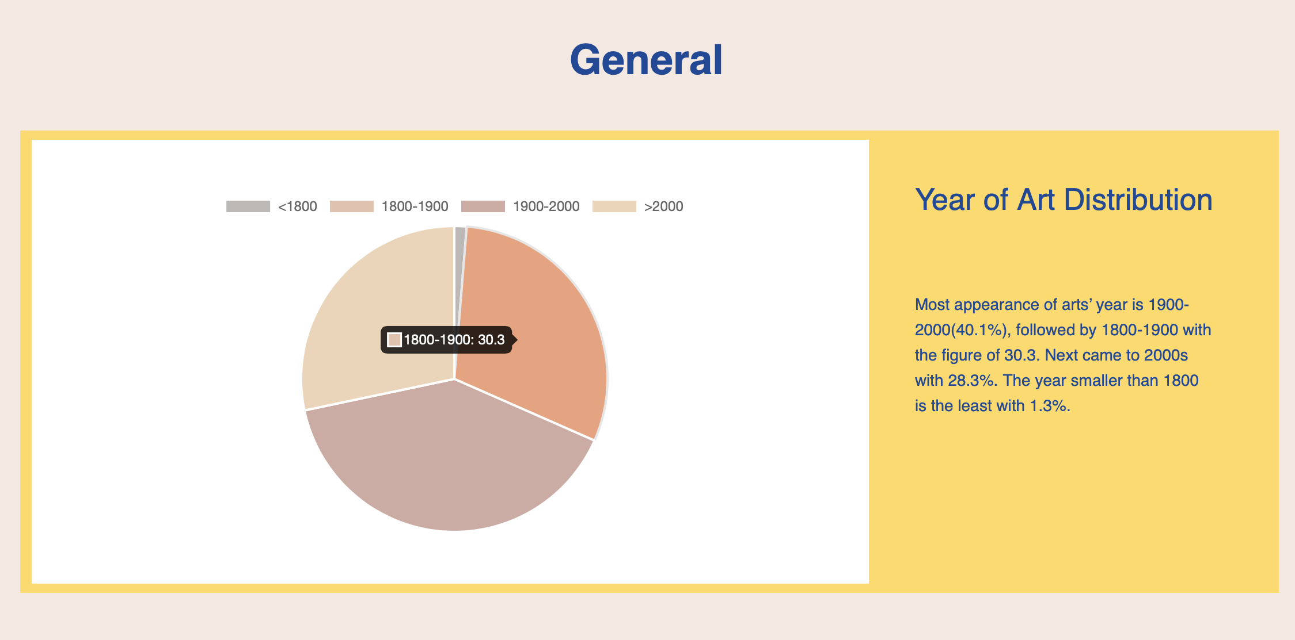
Interactive Screen
Part three:
Some data vasualizations

Slide 18
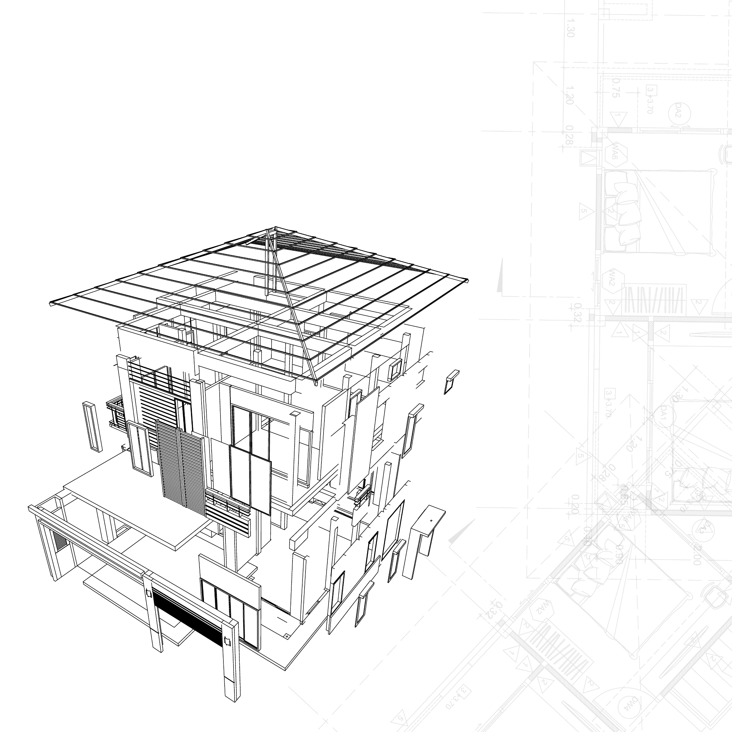

Create beautiful
Reflection - Future work
1.
Considering the cardboard size limitation, we only show the public art time map of the city center in detail. In the future, we can extend it to the entire Edinburgh area.
2. We just make the prototype to link the screen to our physical map. We hope to do further work to make it become a reality.
3. There are still some missing data for the existing year of the public arts in the data set, which need further exploring.

Slide 19
Thank you for listening

